Slide 1


Slide 2
Customer Report (SQL):

Slide 3
Introduction:
The Customer Report Summary generated through SQL query provides deep insights into customer behavior, sales trends, and overall business performance. By analyzing key metrics from the shopping behavior updated dataset, we can understand customer engagement patterns and make data-driven decisions to improve customer satisfaction and increase revenue.
The Key Concepts Include:
Customer Base Overview.
Sales Performance Analysis.
Customer Retention and Churn Analysis.
Customer Segmentation By Payment Method.
Purchase Behavior Analysis.
Revenue Distribution and Product Performance.
Churn Pattern Identification.

Slide 4
Requirements:
Fetch Total Number Of Customers
Identify Active and Churned Customers
Calculate Average Order Value
Calculate Customer Lifetime Value (CLV)
Track Purchase Frequency Per Customer
Identify High-Value, Medium-Value, and Low-Value Customers
Analyze Sales Performance By Product Category
Analyze Sales By Region and Time Period
Track Revenue Growth Over Time
Identify Most Preferred Payment Method
Fetch Top 10 High-Spending Customers
Identify Repeat Customers
Count Cancelled Orders (Churn Analysis)
Calculate Customer Retention Rate
Fetch Last Purchase Date Of Each Customer

Slide 5
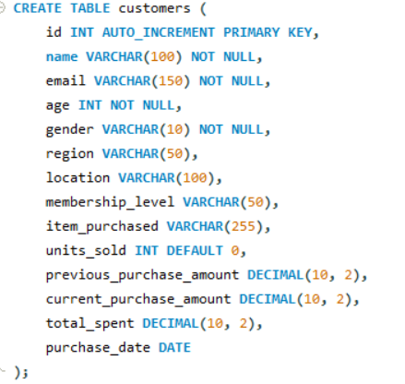
Table Created

Slide 6


Slide 7
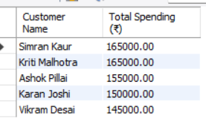
1.Who are the top 5 highest-spending customers, and how much have they spent in total?
SELECT
name as ‘Customer_Name’,
total_spent as ‘Total_Spending ‘
From
Customers
ORDER BY
total_spent DESC
LIMIT 5;

Slide 8
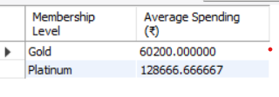
2.What is the average spending of customers in the Platinum membership level compared to Gold?
SELECT
membership_level AS 'Membership Level',
AVG(total_spent) AS 'Average Spending (₹)'
FROM
customers
WHERE
membership_level IN ('Platinum', 'Gold')
GROUP BY
membership_level;

Slide 9
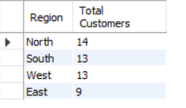
3. How many customers are from each region (North, South, East, West)?
SELECT
region AS 'Region',
COUNT(*) AS 'Total Customers'
FROM
customers
GROUP BY
region;

Slide 10

4.What is the gender distribution of customers in the Gold membership level?
SELECT
gender AS 'Gender',
COUNT(*) AS 'Total Customers'
FROM
customers
WHERE
membership_level = 'Gold'
GROUP BY
gender;

Slide 11

5.Which product category (item_purchased) is the most frequently sold?
SELECT
item_purchased AS 'Product Category',
COUNT(*) AS 'Units Sold'
FROM
customers
GROUP BY
item_purchased
ORDER BY
COUNT(*) DESC
LIMIT 1;

Slide 12

6.Who has purchased the highest number of units and what did they buy?
SELECT
name AS 'Customer Name',
item_purchased AS 'Item Purchased',
units_sold AS 'Units Sold'
FROM
customers
ORDER BY
units_sold DESC
LIMIT 1;

Slide 13

7.What is the total revenue generated from customers aged 30 and above?
SELECT
SUM(total_spent) AS 'Total Revenue (₹)'
FROM
customers
WHERE
age >= 30;

Slide 14

8.Which region contributes the most to the total sales amount?
SELECT
region AS 'Region',
SUM(total_spent) AS 'Total Sales (₹)'
FROM
customers
GROUP BY
region
ORDER BY
SUM(total_spent) DESC
LIMIT 1;

Slide 15

9.How many customers have made multiple purchases
SELECT
COUNT(*) AS 'Customers with Multiple Purchases'
FROM
customers
WHERE
previous_purchase_amount > 0;

Slide 16

10.What is the total number of customers who purchased within the last 30 days?
SELECT
COUNT(*) AS 'Customers Purchased in Last 30 Days'
FROM
customers
WHERE
purchase_date >= CURDATE() - INTERVAL 30 DAY;

Slide 17
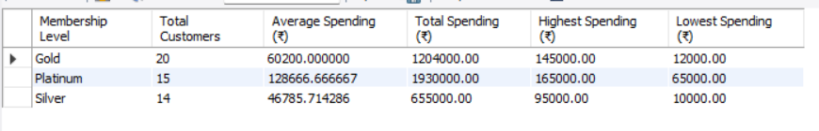
11.How does the spending behavior vary across different membership levels (Silver, Gold, Platinum)?
SELECT
membership_level AS 'Membership Level',
COUNT(*) AS 'Total Customers',
AVG(total_spent) AS 'Average Spending (₹)',
SUM(total_spent) AS 'Total Spending (₹)',
MAX(total_spent) AS 'Highest Spending (₹)',
MIN(total_spent) AS 'Lowest Spending (₹)'
FROM
customers
GROUP BY
membership_level
ORDER BY
membership_level ASC;

Slide 18

12.Which membership level has the most number of customers?
SELECT
membership_level AS 'Membership Level',
COUNT(*) AS 'Total Customers'
FROM
customers
GROUP BY
membership_level
ORDER BY
COUNT(*) DESC
LIMIT 1;

Slide 19

13.What is the most recent purchase date, and who made the purchase?
SELECT
name AS 'Customer Name',
purchase_date AS 'Purchase Date'
FROM
customers
ORDER BY
purchase_date DESC
LIMIT 1;

Slide 20

14.How many customers have made purchases in the current month?
SELECT
COUNT(*) AS 'Customers Purchased This Month'
FROM
customers
WHERE
MONTH(purchase_date) = MONTH(CURDATE()) AND
YEAR(purchase_date) = YEAR(CURDATE());

Slide 21
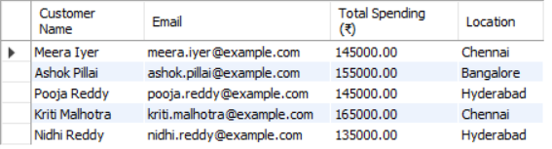
15.Who are the customers with total spending exceeding ₹1,00,000 and located in the South region?
SELECT
name AS 'Customer Name',
email AS 'Email',
total_spent AS 'Total Spending (₹)',
location AS 'Location'
FROM
customers
WHERE
total_spent > 100000 AND
region = 'South';

Slide 22
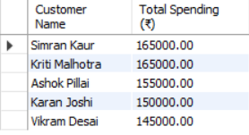
16.Which customers have purchased more than 3 units in a single transaction?
SELECT
name AS 'Customer Name',
total_spent AS 'Total Spending (₹)'
FROM
customers
ORDER BY
total_spent DESC
LIMIT 5;

Slide 23

17.Which customers made purchases in multiple regions, and what items did they buy in each location?
SELECT
name AS 'Customer Name',
region AS 'Region',
item_purchased AS 'Item Purchased'
FROM
customers
WHERE
name IN (
SELECT name
FROM customers
GROUP BY name
HAVING COUNT(DISTINCT region) > 1
)
ORDER BY
name, region;

Slide 24
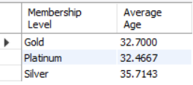
18.What is the average age of customers for each membership level?
SELECT
membership_level AS 'Membership Level',
AVG(age) AS 'Average Age'
FROM
customers
GROUP BY
membership_level
ORDER BY
membership_level ASC;

Slide 25

19.How many customers made purchases during weekends, and how much did they spend in total?
SELECT
COUNT(*) AS 'Customers Purchased on Weekends',
SUM(total_spent) AS 'Total Spending on Weekends (₹)'
FROM
customers
WHERE
DAYOFWEEK(purchase_date) IN (1, 7);

Slide 26

20.How many customers have consistently purchased at least one product every month this year?
SELECT
name AS 'Customer Name',
COUNT(DISTINCT MONTH(purchase_date)) AS 'Months with Purchases'
FROM
customers
WHERE
YEAR(purchase_date) = YEAR(CURDATE())
GROUP BY
name
HAVING
COUNT(DISTINCT MONTH(purchase_date)) = MONTH(CURDATE());

Slide 27
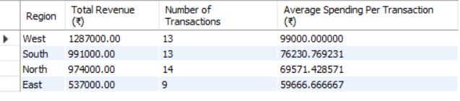
21.Based on past purchases, which regions are likely to generate the highest revenue in the next quarter?
SELECT
region AS 'Region',
SUM(total_spent) AS 'Total Revenue (₹)',
COUNT(*) AS 'Number of Transactions',
AVG(total_spent) AS 'Average Spending Per Transaction (₹)'
FROM
customers
WHERE
purchase_date >= DATE_SUB(CURDATE(), INTERVAL 3 MONTH)
GROUP BY
region
ORDER BY
SUM(total_spent) DESC;

Slide 28
Conclusion
Successfully identified different customer groups based on their purchasing behavior and demographics, helping in targated marketing.
Analyzed sales patterns to understand peak shopping periods and seasonal demand, improving sales forecasting.
Determined the top-performing products and those with low sales to optimize inventory management.
Identified factors leading to customer churn and suggested strategies to improve customer loyalty and retention.
Analyzed revenue contribution from various customer segments and regions to enhance sales strategies.

Slide 29
Calculated customer lifetime value to target high-value customers and design personalized marketing
Campaigns.
Assessed the effectiveness of discount campaigns on sales growth and customer acquisition.
Identified high-sales regions and areas requiring focused marketing efforts to boost sales.
Analyzed customer feedback to enhance service quality and overall customer experience.
Provided actionable insights to improve business strategies and customer engagement for long-term growth.

Slide 30


